Slide 1
MICRO MOUSE MAZE
TEAM NAME : HORIZON
SHAASTRA-IIT MADRAS 2019

Slide 2
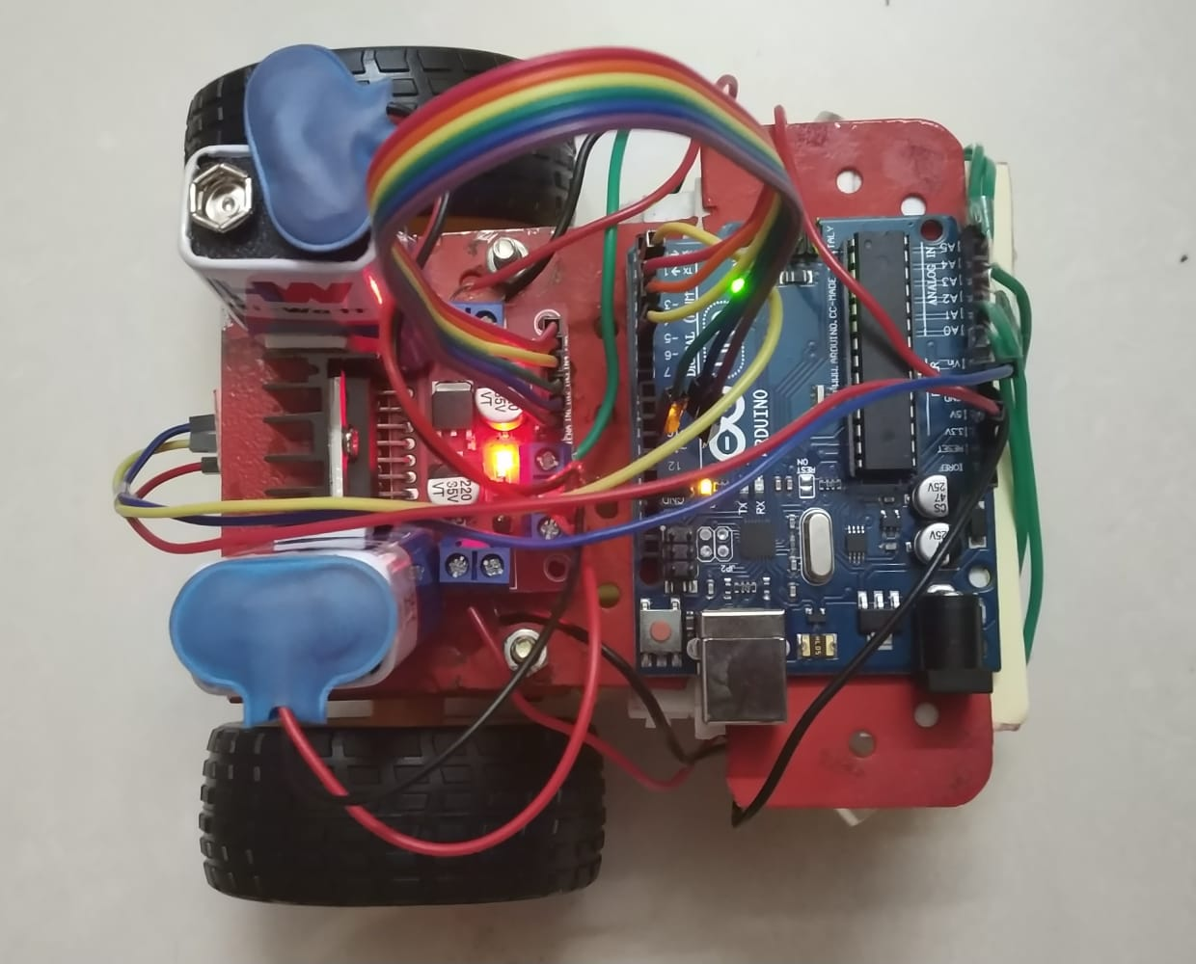
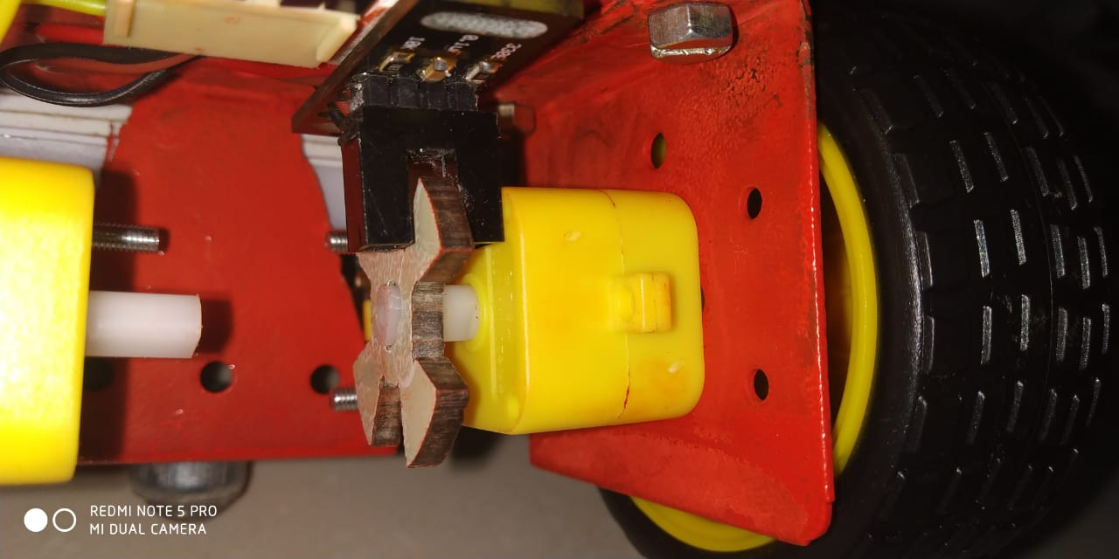
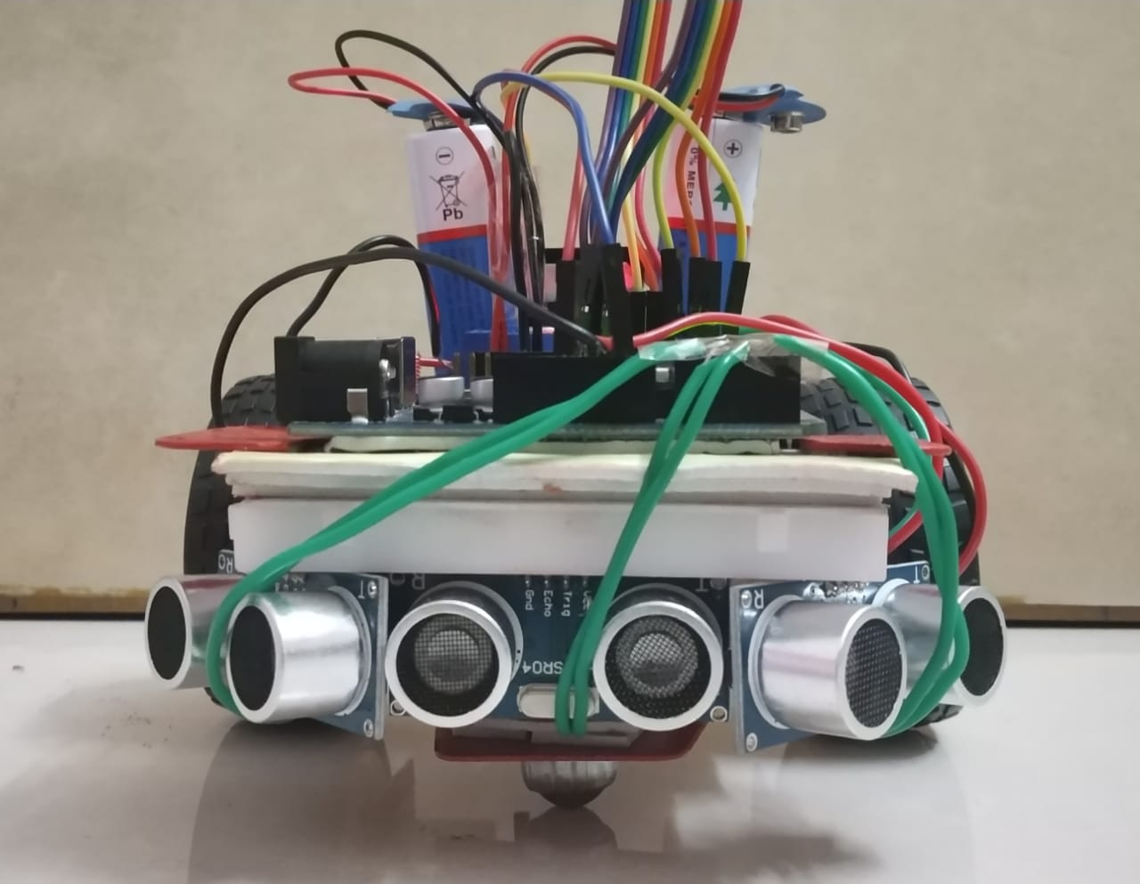
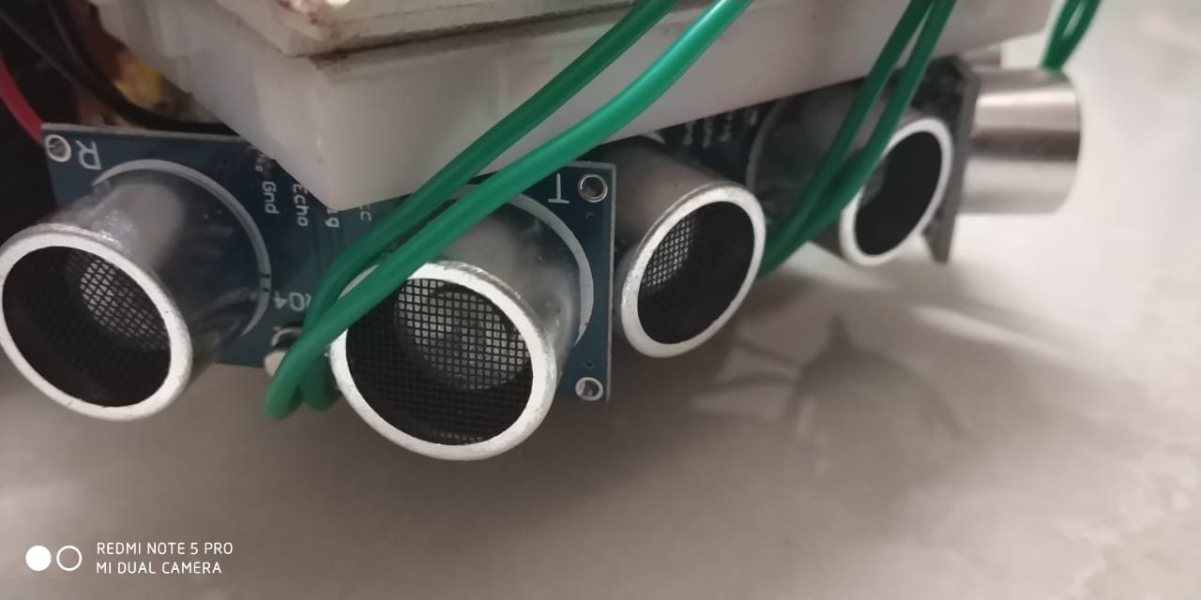
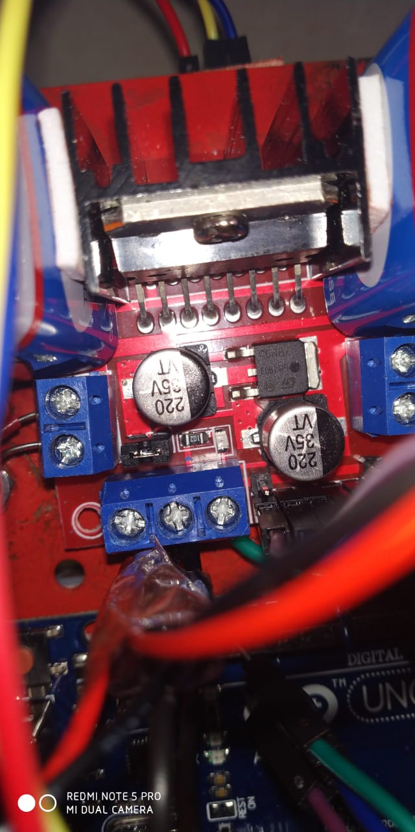
MICRO-MOUSE MAZE SOLVER ROBOT
Opto-coupler Encoder
Arduino UNO
Ultrasonic Sensor
Micro-Mouse Maze Solver Robot
Motor Driver

Slide 3
COMPONENTS USED:

Slide 4
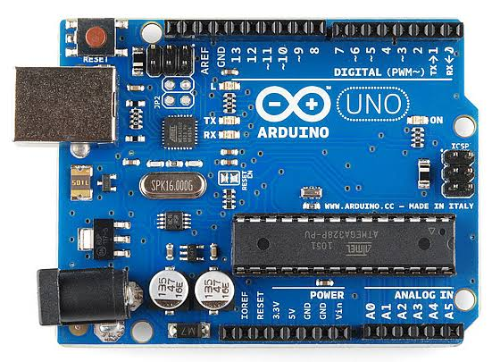
ARDUINO UNO

Slide 5
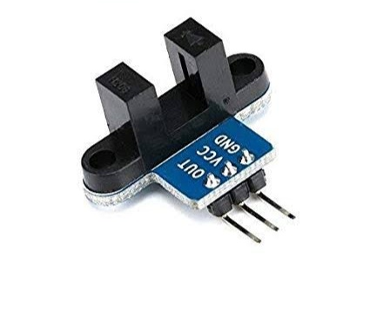
OPTO COUPLER ENCODER – LM393
A current is first applied to the Optocoupler, which makes the infrared LED emit a light that’s proportional to the current. When the light hits the photosensitive device, it switches on and starts to conduct a current as any ordinary transistor might. This is used in encoder.

Slide 6
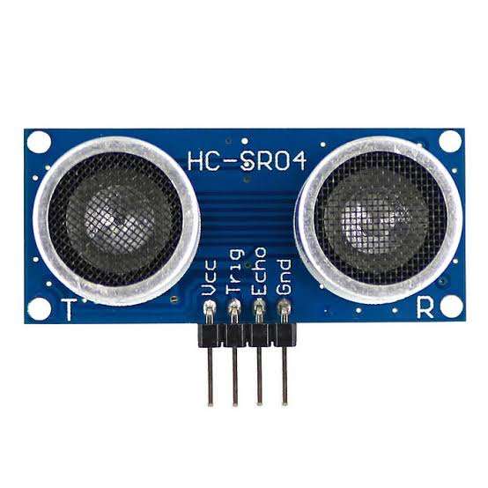
ULTRASONIC SENSOR – HC-SR04
Ultrasonic sensors work by emitting sound waves at a frequency too high for humans to hear. They then wait for the sound to be reflected back, calculating distance based on the time required. This is similar to how radar measures the time it takes a radio wave to return after hitting an object. This is used to measure the distance travelled by the robot.

Slide 7
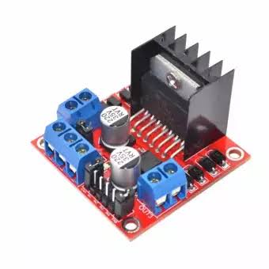
MOTOR DRIVER – L298N
A motor driver IC is an integrated circuit chip which is usually used to control motors in autonomous robots. Motor driver ICs act as an interface between microprocessors in robots and the motors in the robot. The most commonly used motor driver IC’s are from the L293 series such as L293D, L293NE, etc. These ICs are designed to control 2 DC motors simultaneously. L293D consist of two H-bridge. H-bridge is the simplest circuit for controlling a low current rated motor. Motor Driver ICs are primarily used in autonomous robotics only. Also most microprocessors operate at low voltages and require a small amount of current to operate while the motors require a relatively higher voltages and current . Thus current cannot be supplied to the motors from the microprocessor. This is the primary need for the motor driver IC.

Slide 8
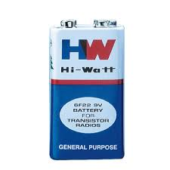
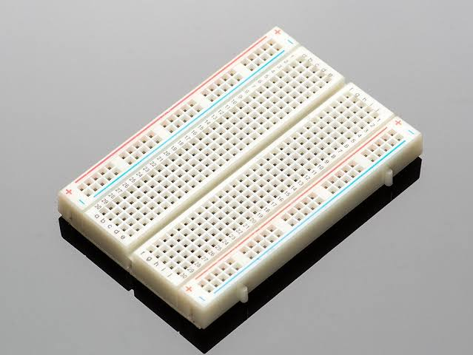
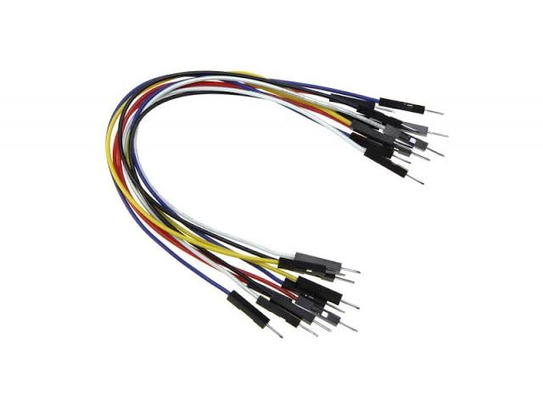
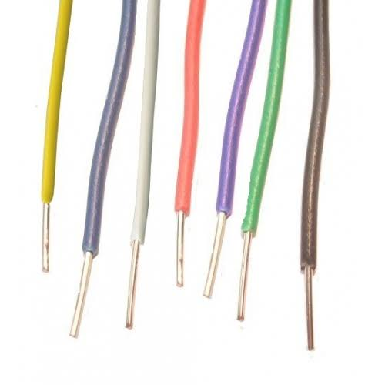
BATTERY, WIRES AND BREADBOARD

Slide 9
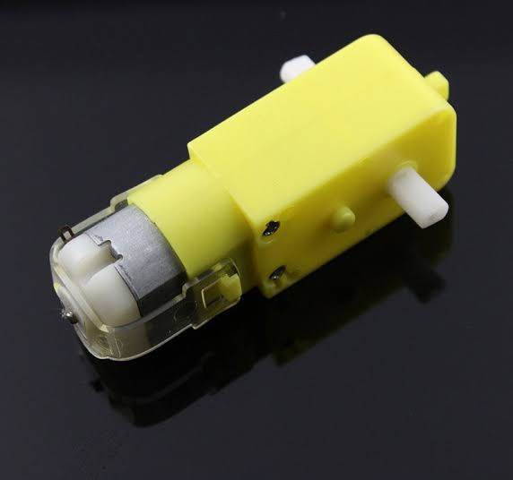
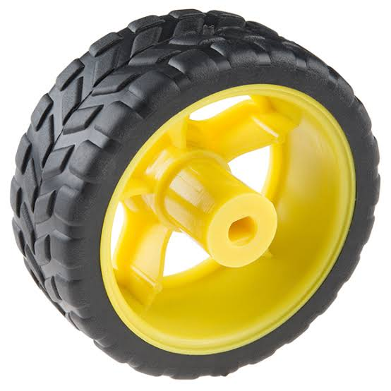
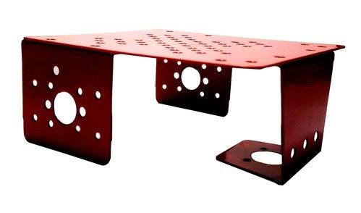
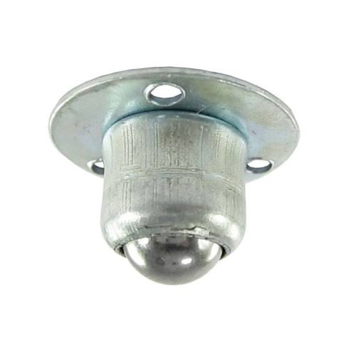
CHASSIS, WHEELS, CASTER WHEEL AND DC-MOTORS

Slide 10
MAZE SOLVING ALGORITHM
-Modified Flood Fill Algorithm

Slide 11
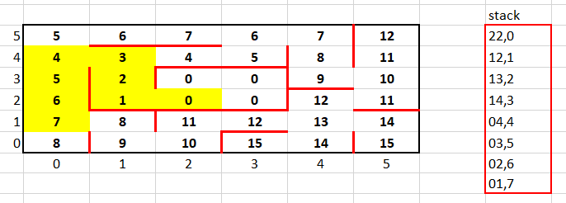
ALGORITHM DESCRIPTION:
The Flood Fill algorithm works by assigning value for all nodes in the maze, where these values indicate the steps from any cell to the destination node.
Once the micro-mouse reaches a particular node it updates its flood value to 1 + minimum flood value of the open neighbour node, propagates the flood values and moves to the node which has the smallest flood value.
The Modified Flood Fill Algorithm is the further extension of the Flood Fill algorithm where the flood value of the present node is updated only if required to do so else continues its motion in a greater pace.
Here in our Algorithm, after propagating the flood values to all the adjacent neighbouring nodes, the flood value of the present node is checked. Not every node travelled by the micro-mouse robot but only the nodes which is 1 less than the flood value of the previously stored node’s flood value, is pushed to the dynamically allocated stack for keeping track of the preferred path to destination cell.
In this way only one final exact path to the destination node will be stored which solves the algorithm to solve the entire maze by the micro-mouse maze efficiently.

Slide 12
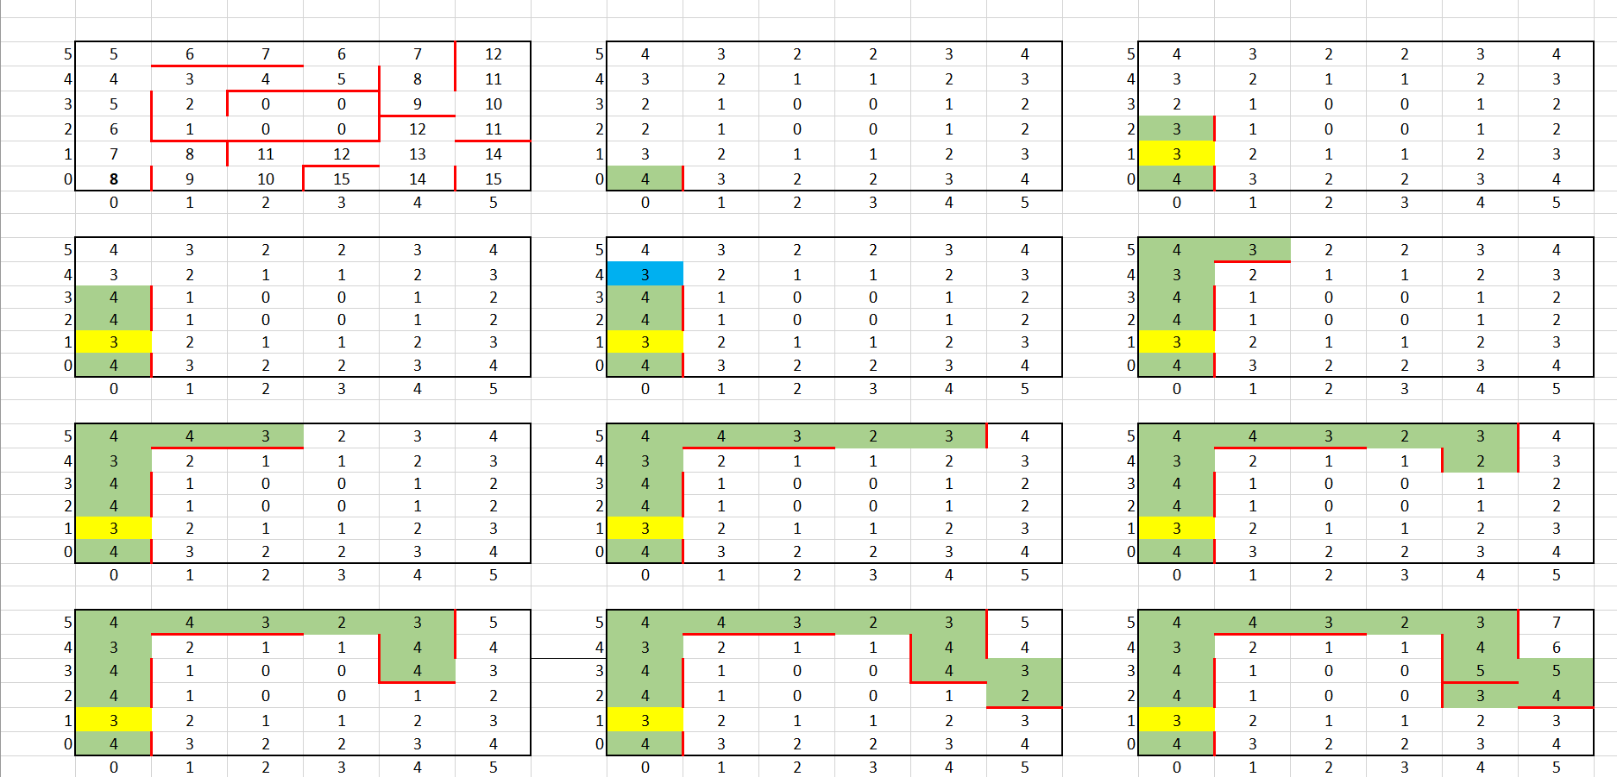
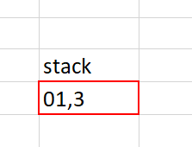
Propagation And Storing Of Flood values:

Slide 13
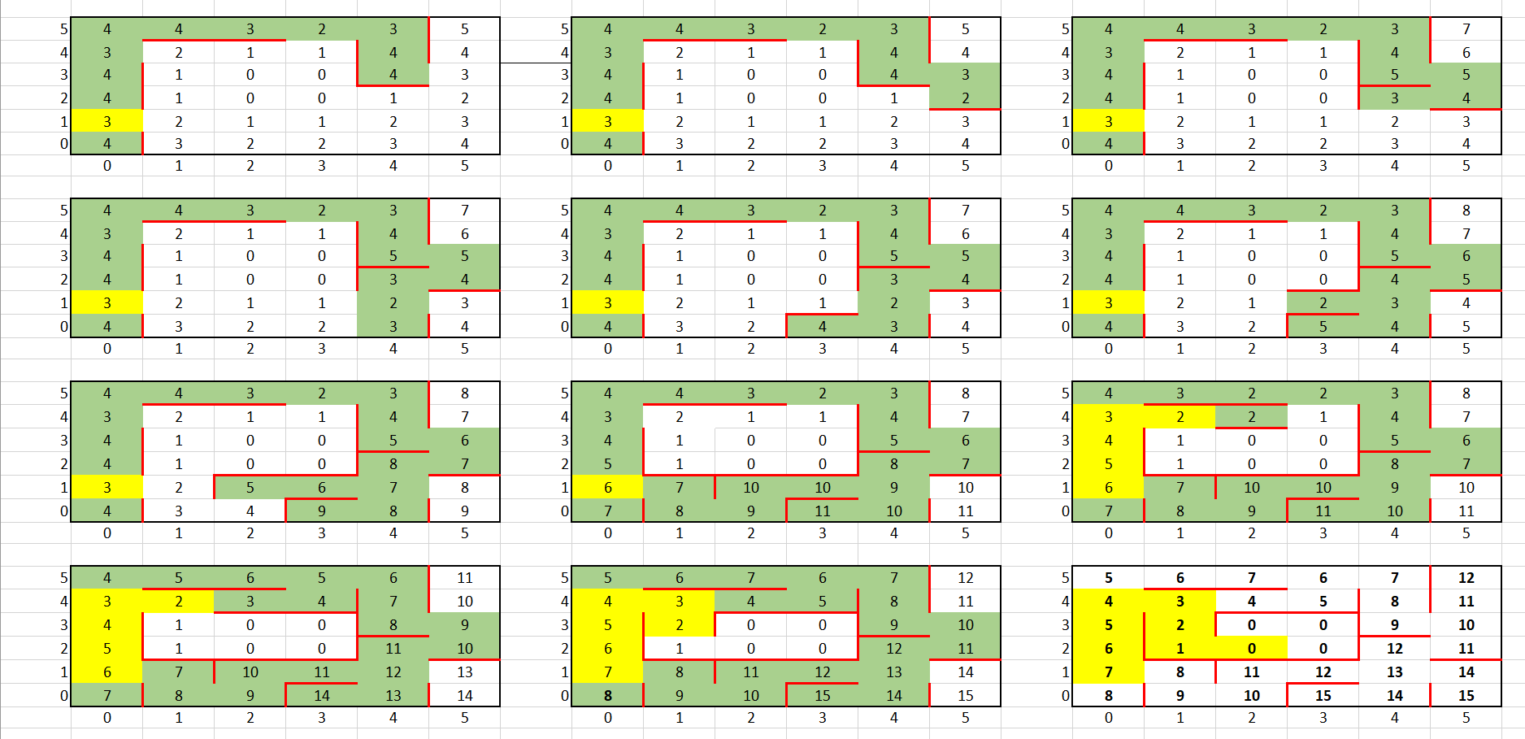
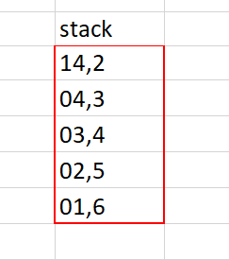
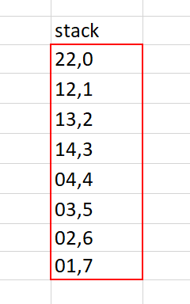
Propagation And Storing Of Flood values:

Slide 14
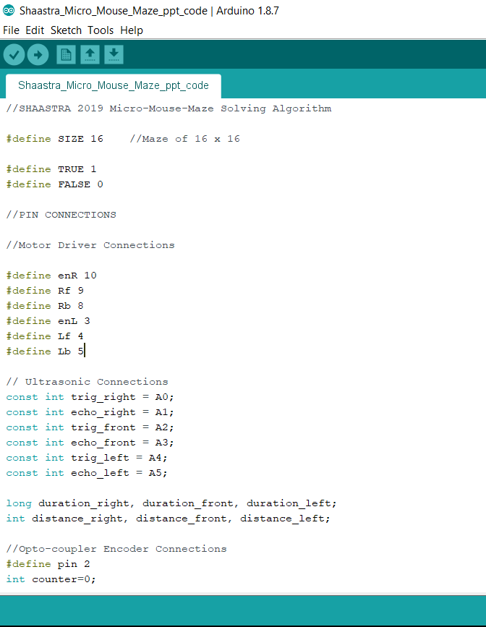
SHAASTRA 2019 MICRO-MOUSE MAZE SOLVING PROGRAM CODE

Slide 15
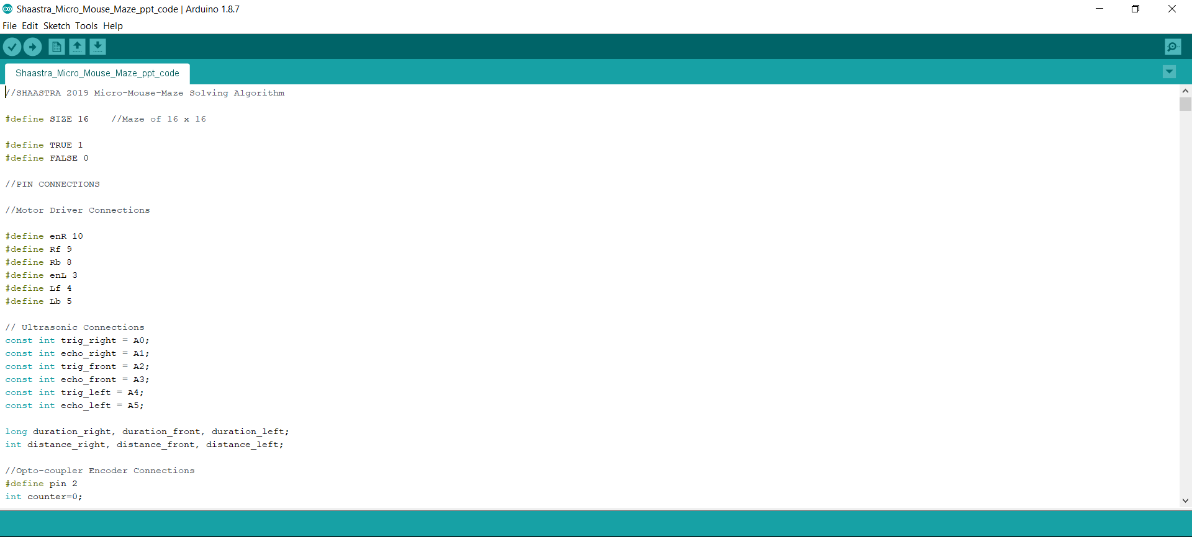

Slide 16
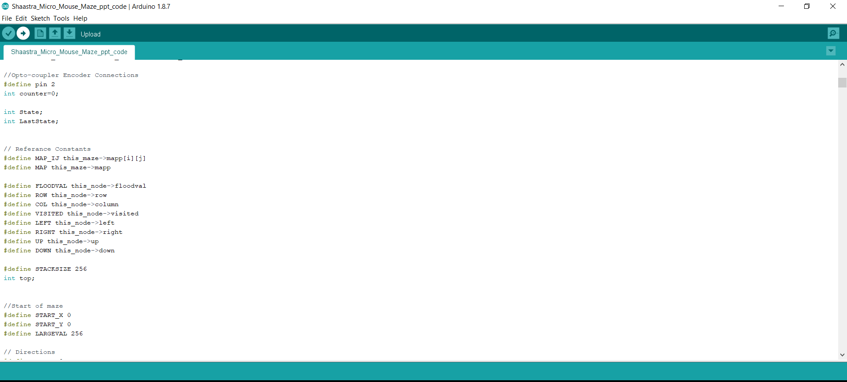

Slide 17
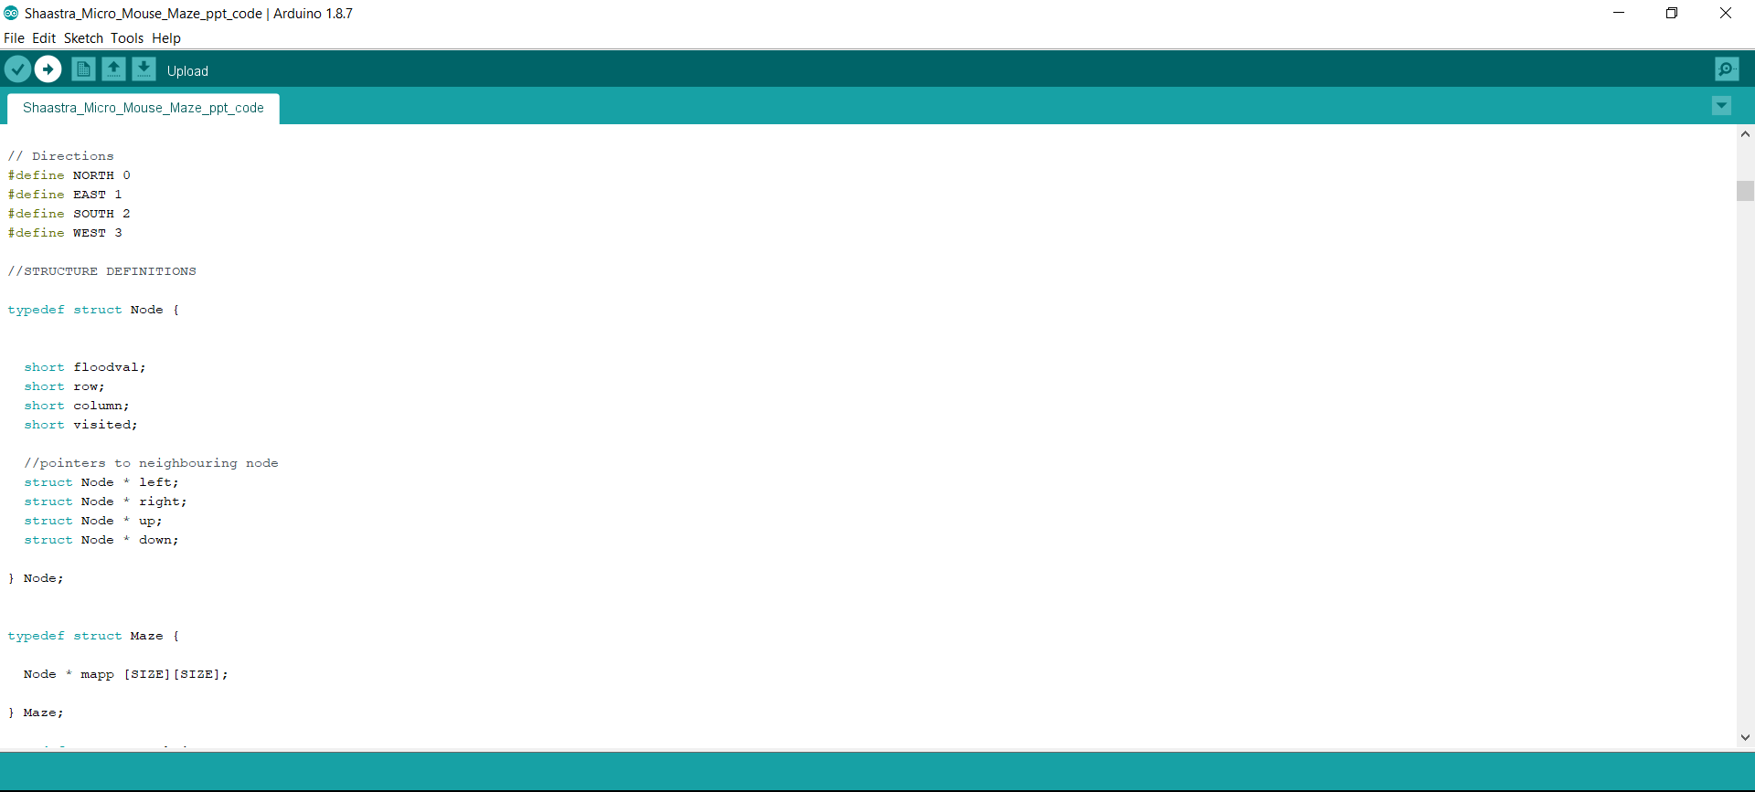

Slide 18
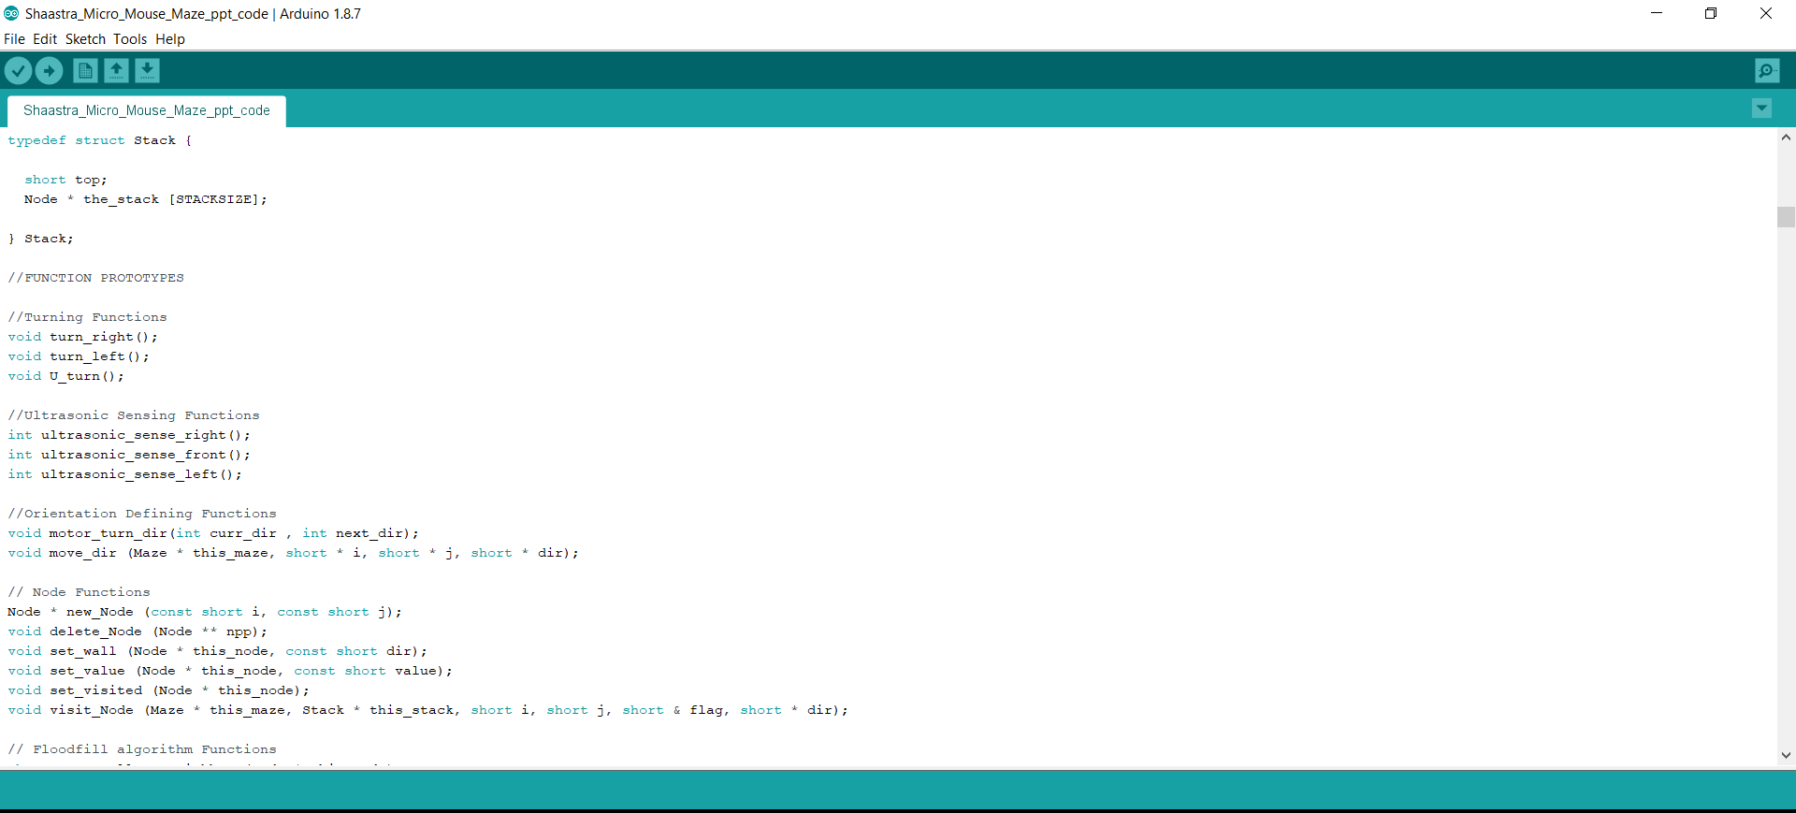

Slide 19
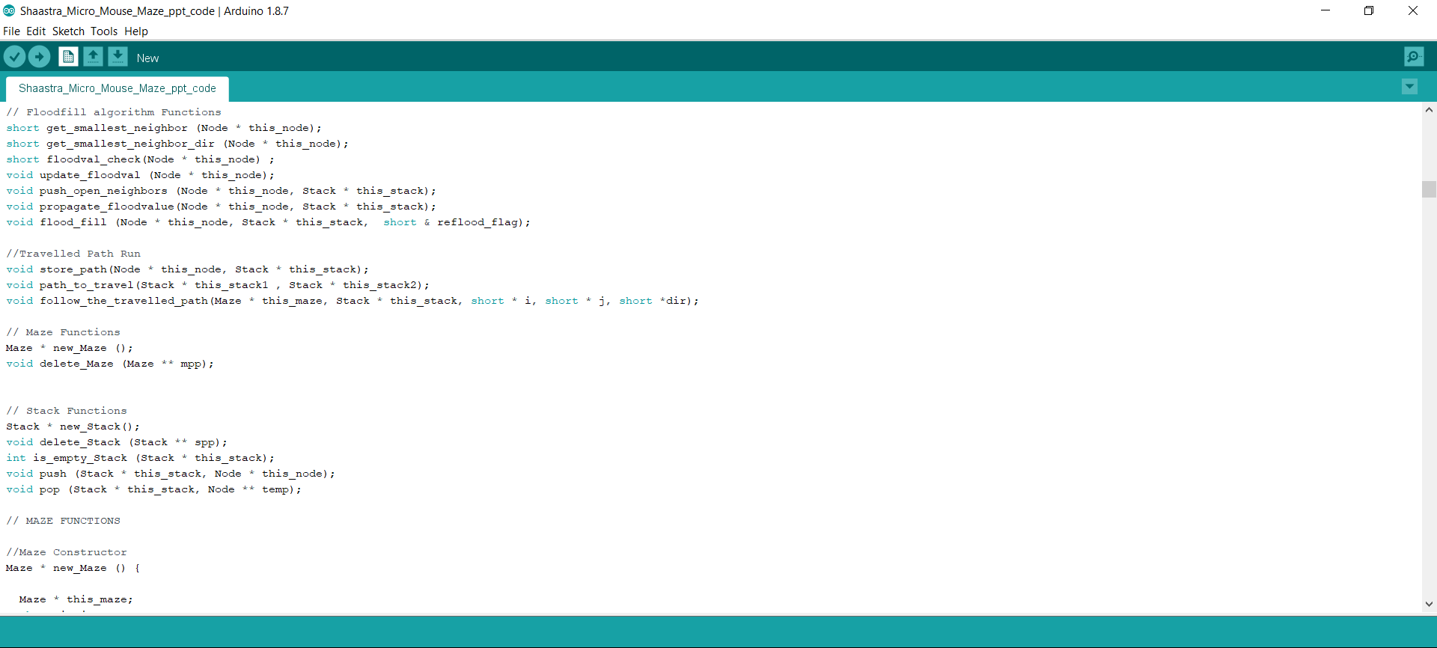

Slide 20
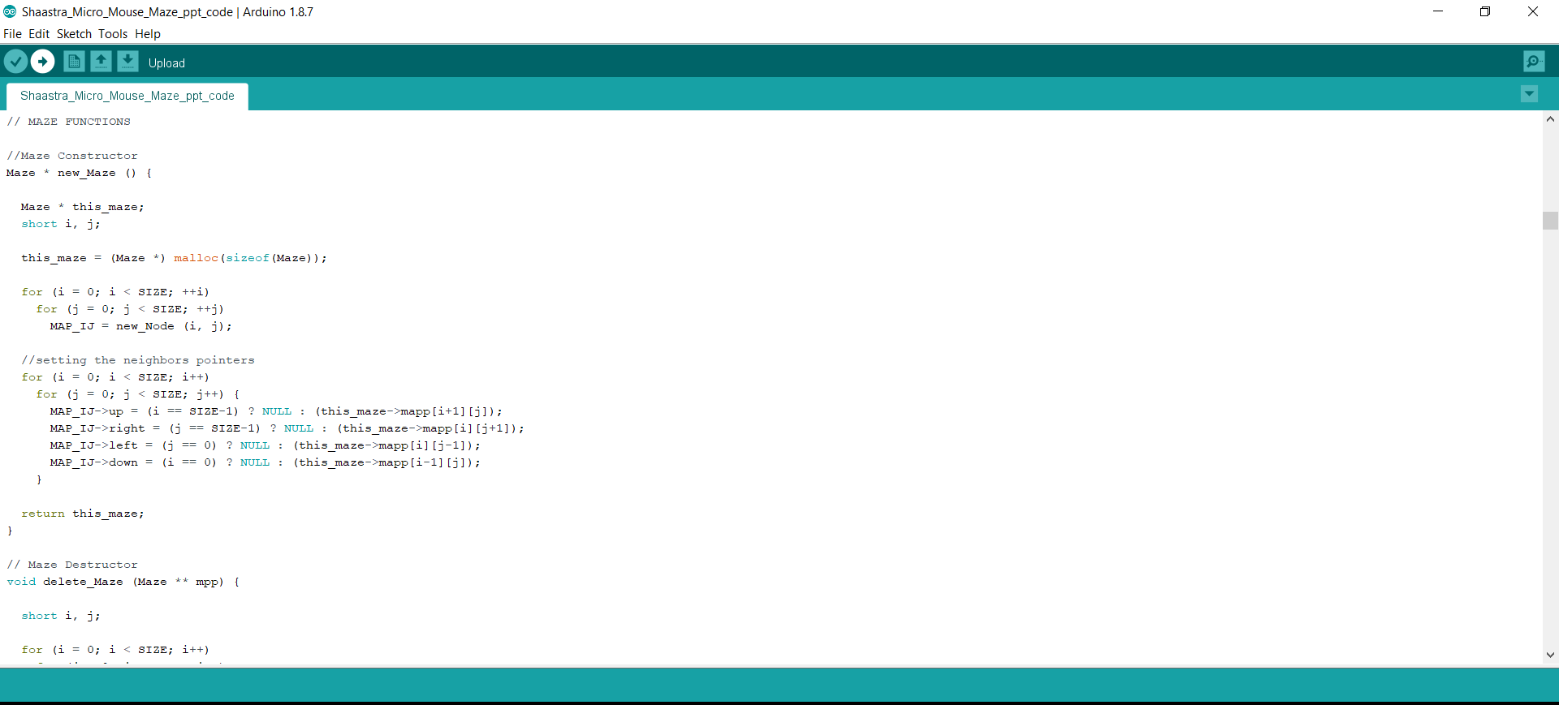

Slide 21
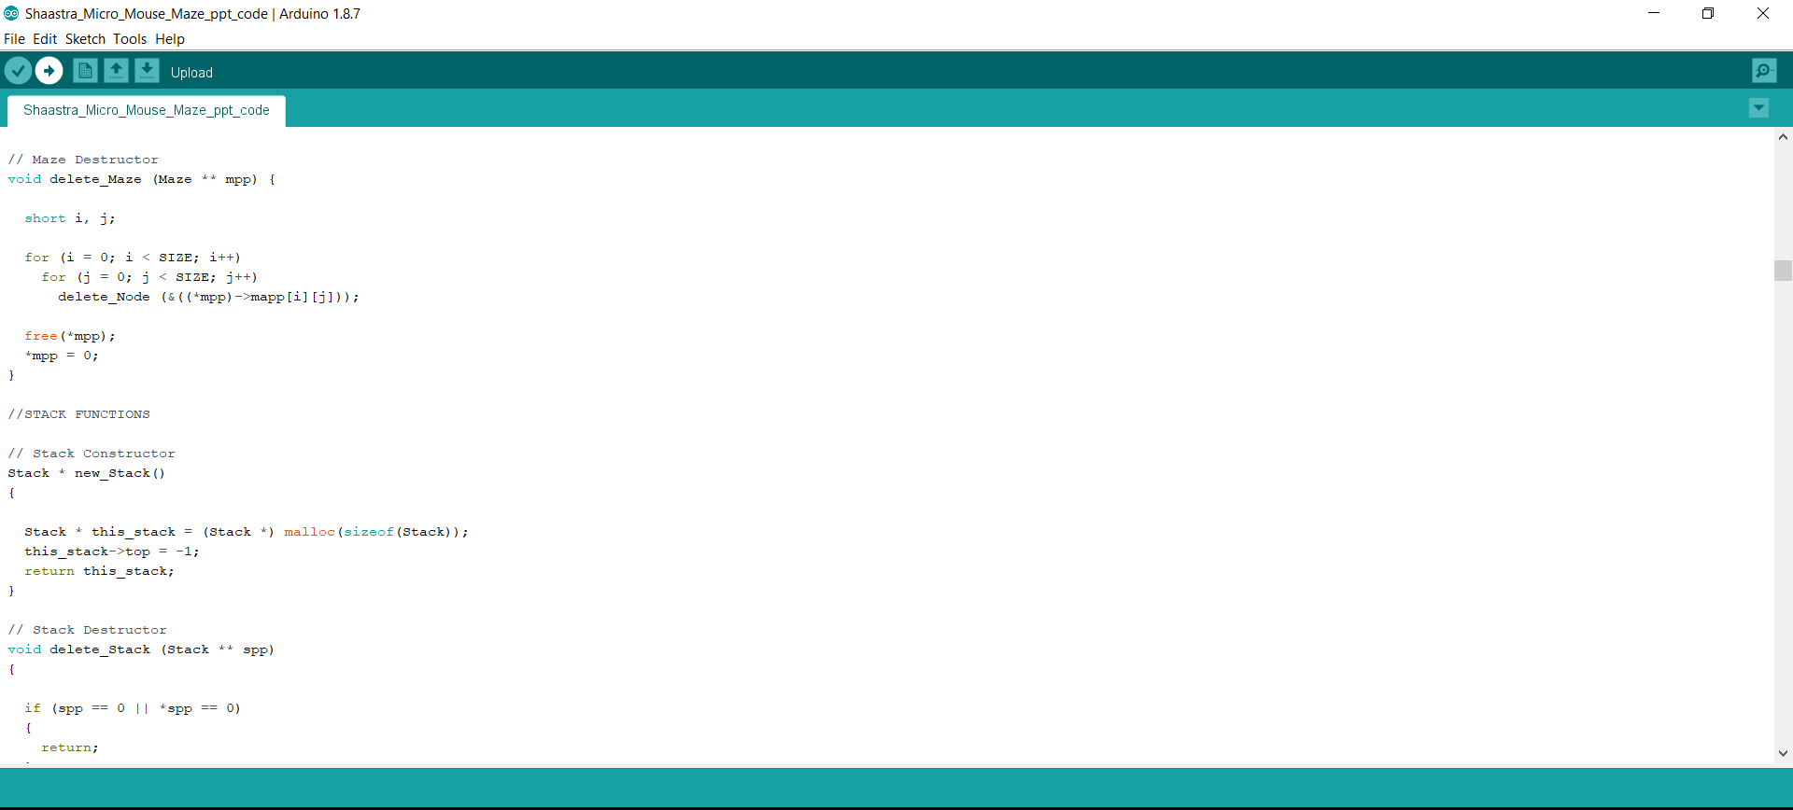

Slide 22
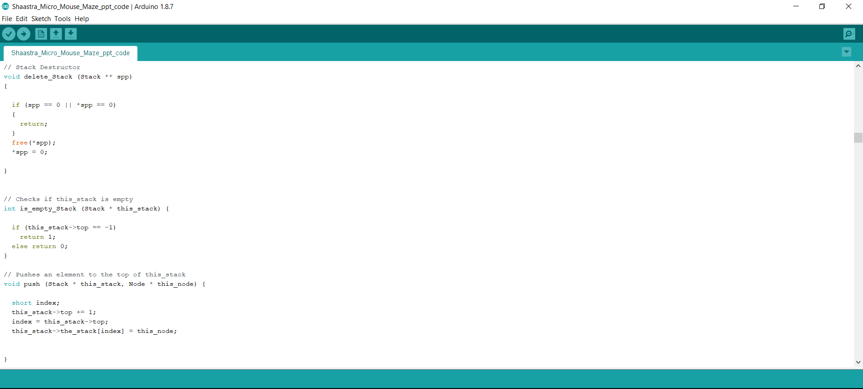

Slide 23
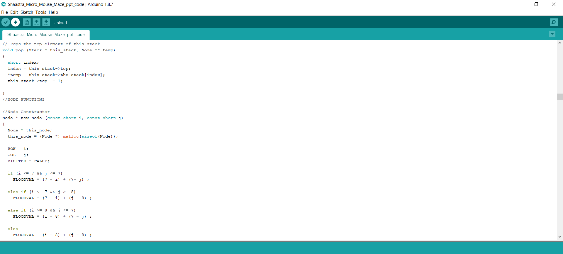

Slide 24
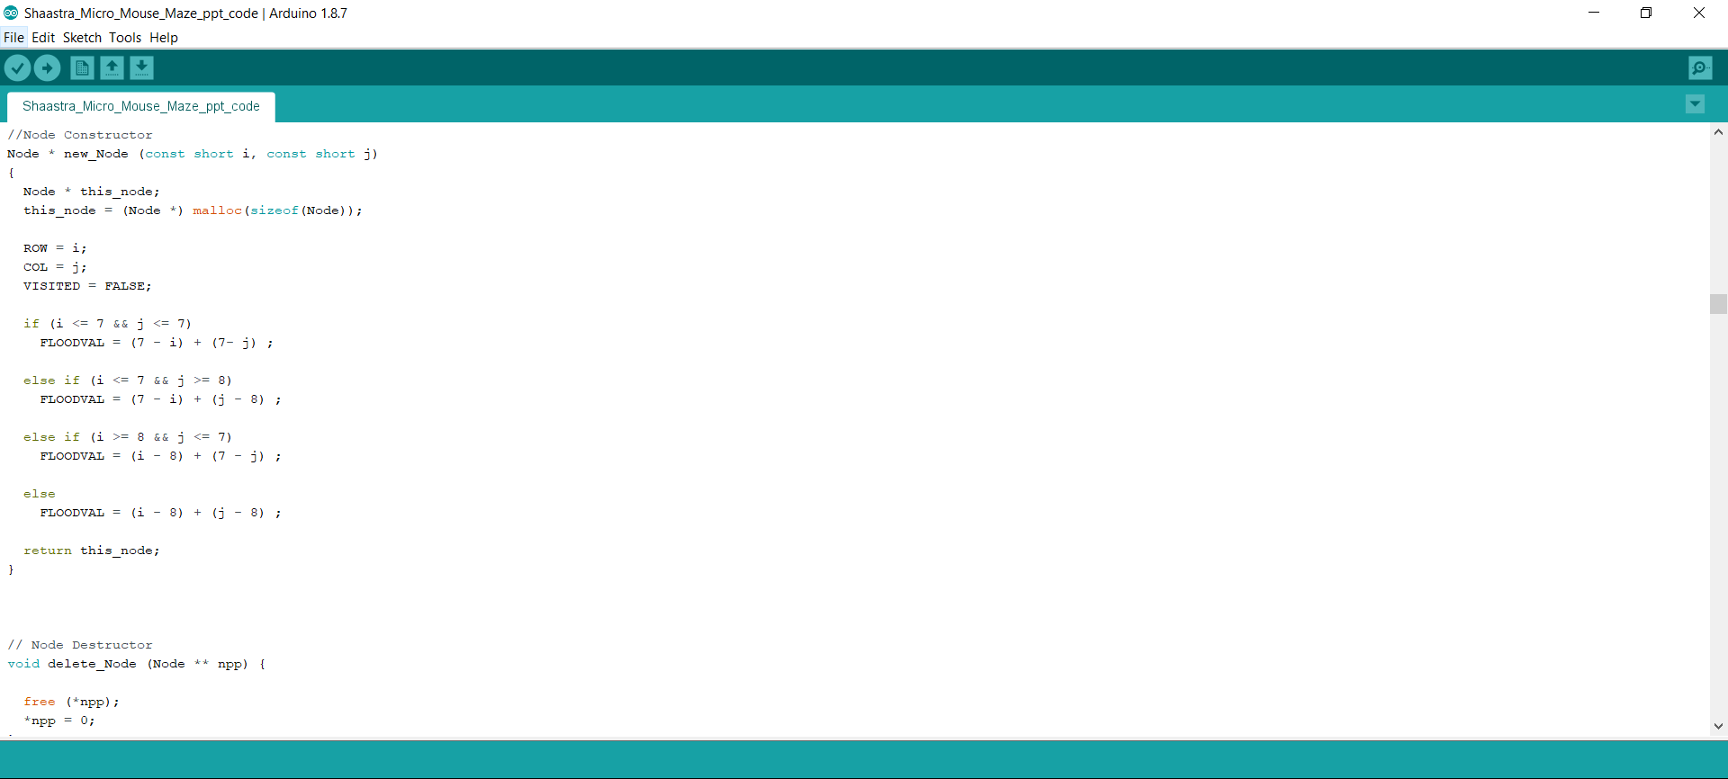

Slide 25
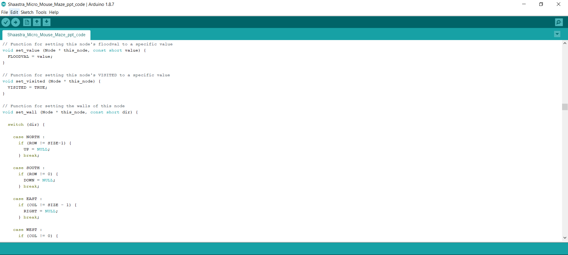

Slide 26
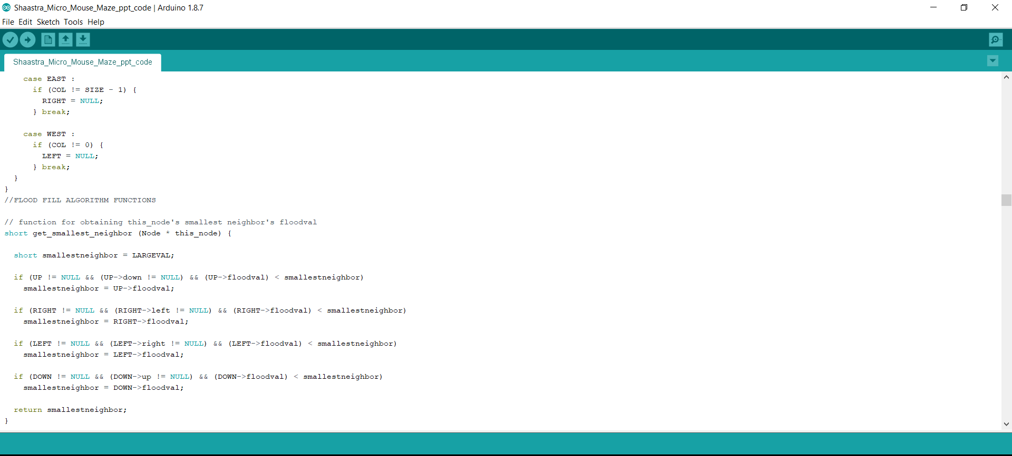

Slide 27
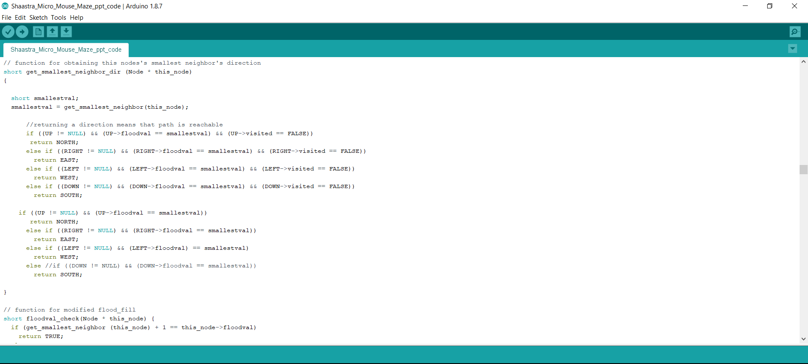

Slide 28
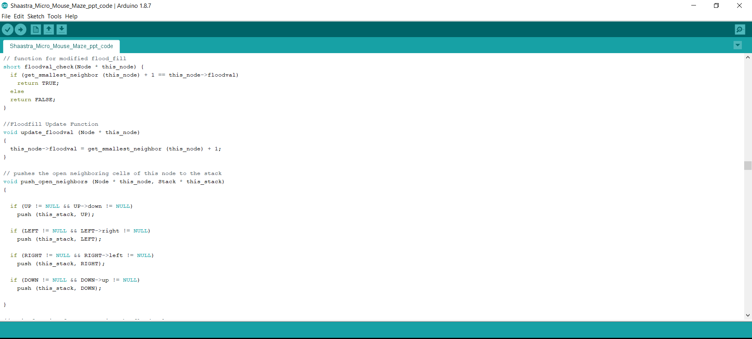

Slide 29
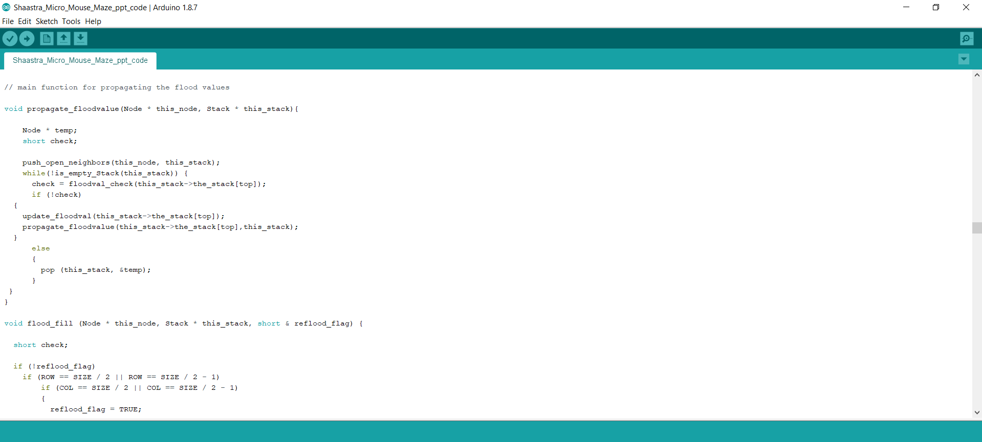

Slide 30
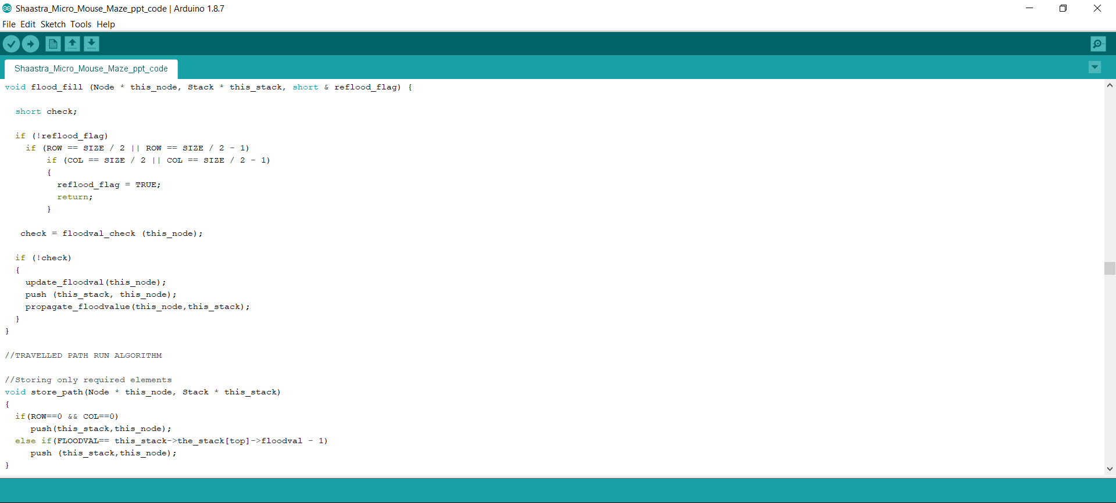

Slide 31
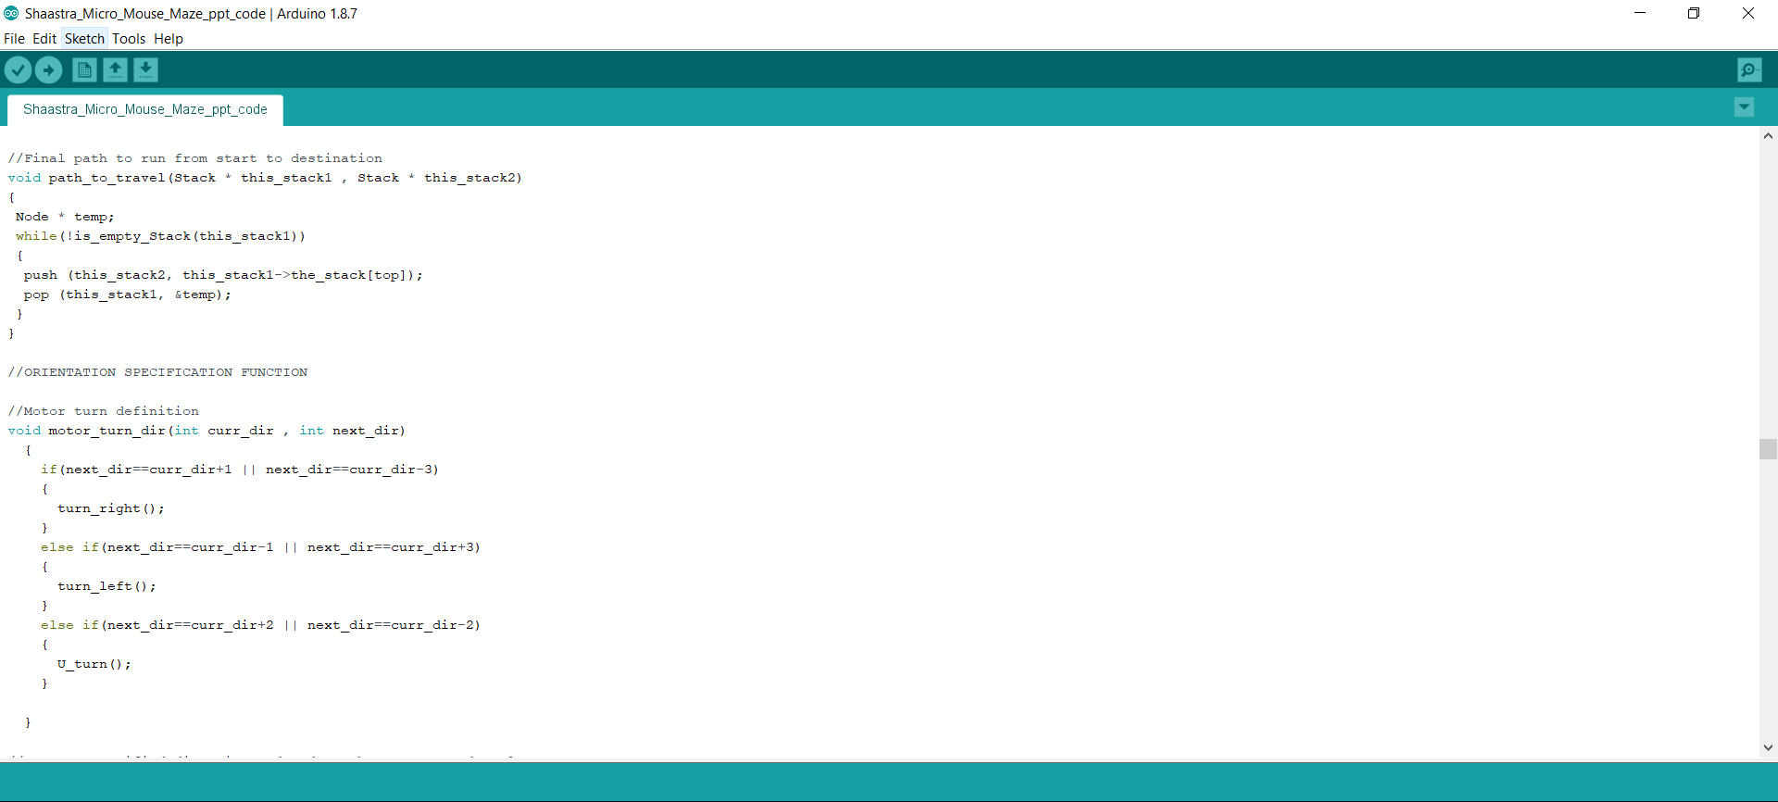

Slide 32
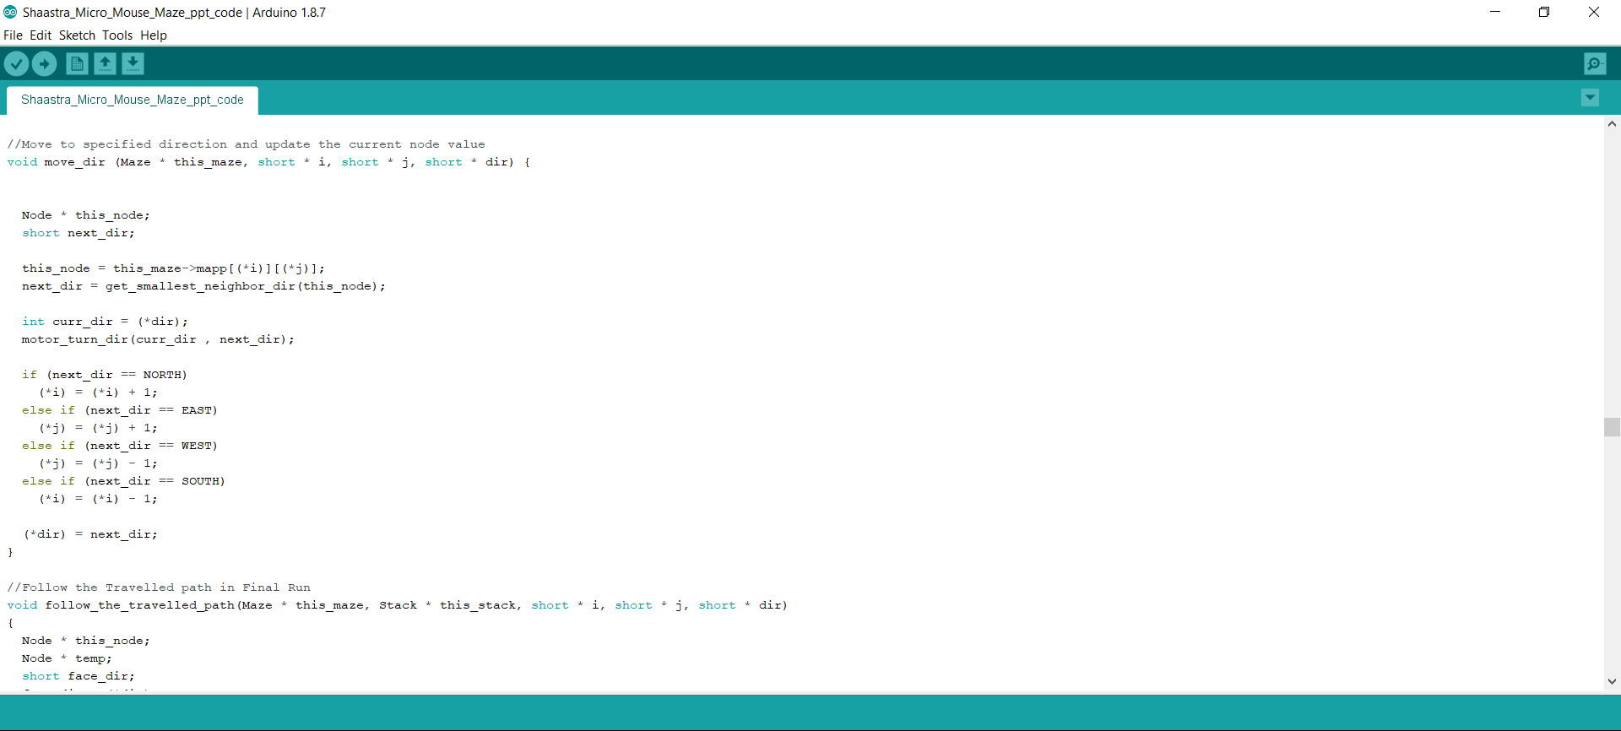

Slide 33
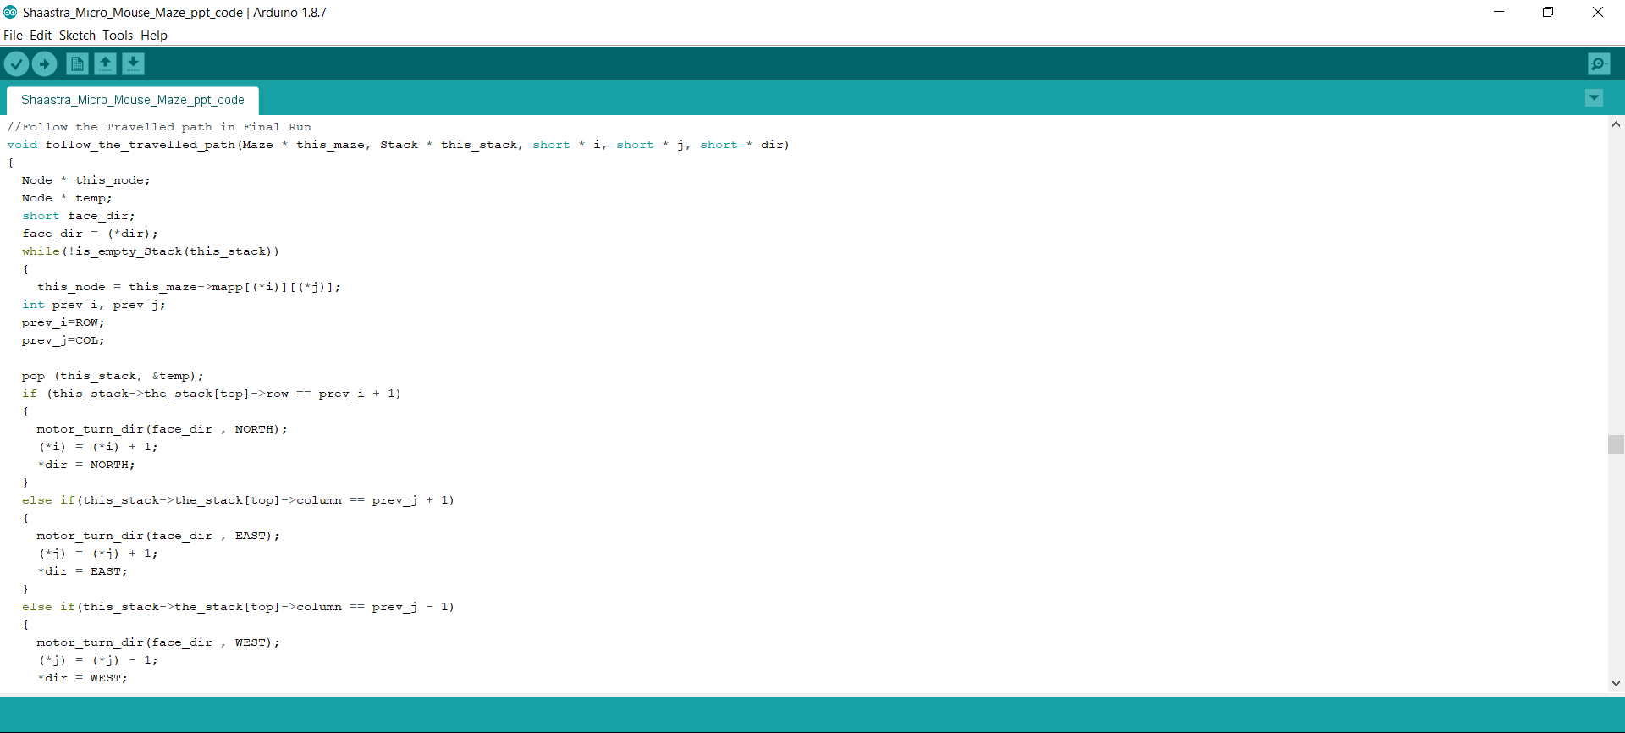

Slide 34
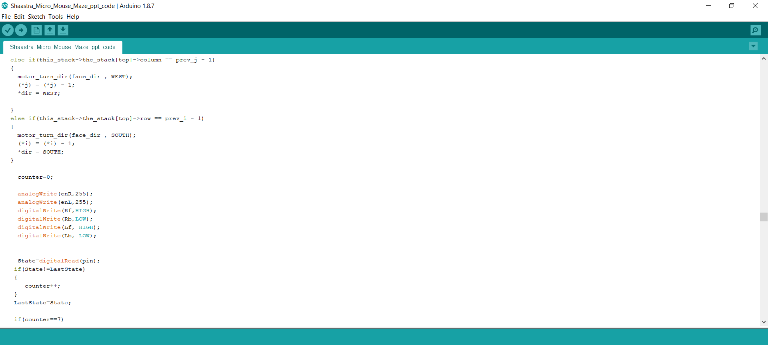

Slide 35
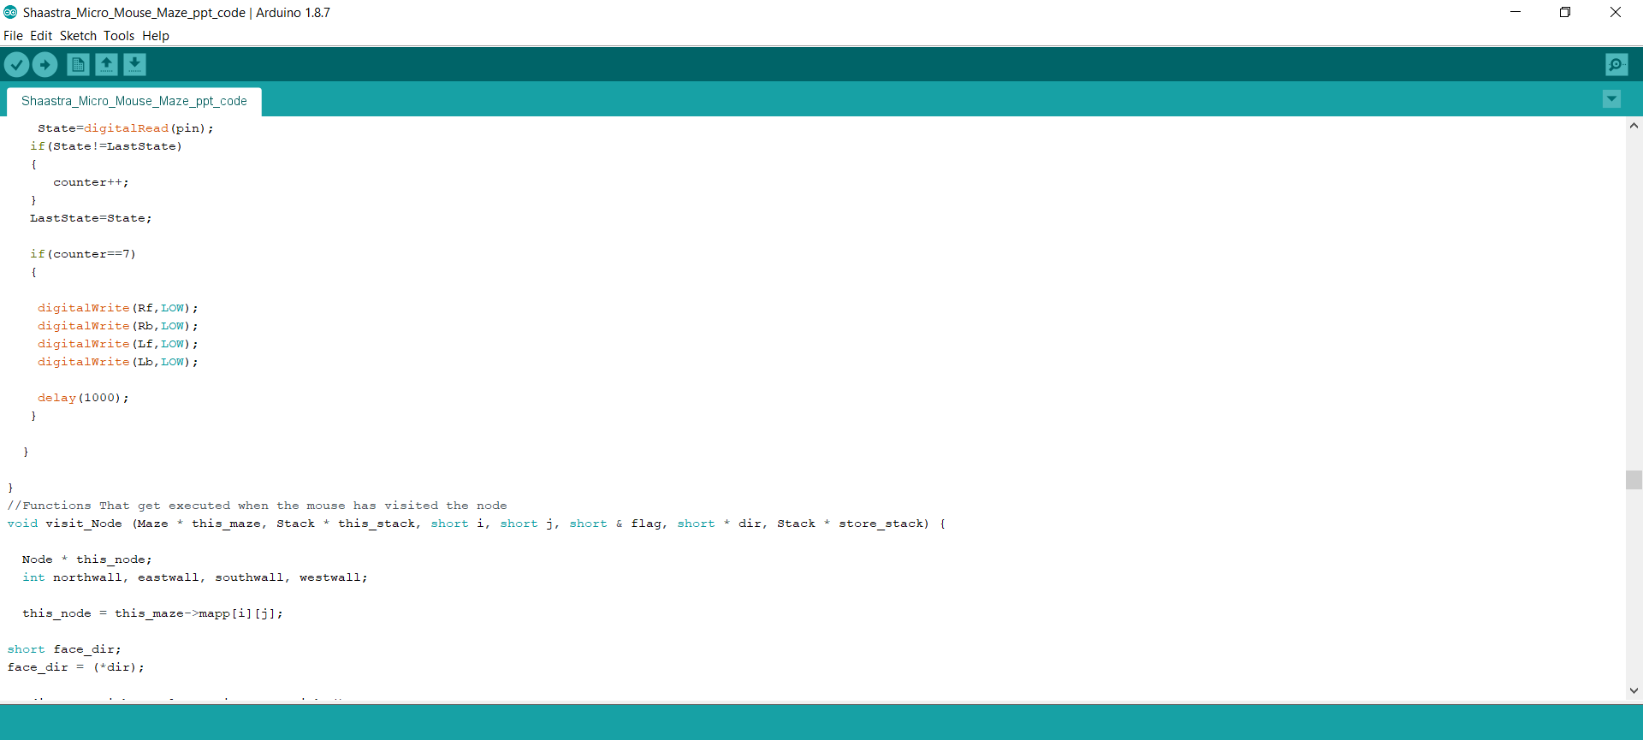

Slide 36
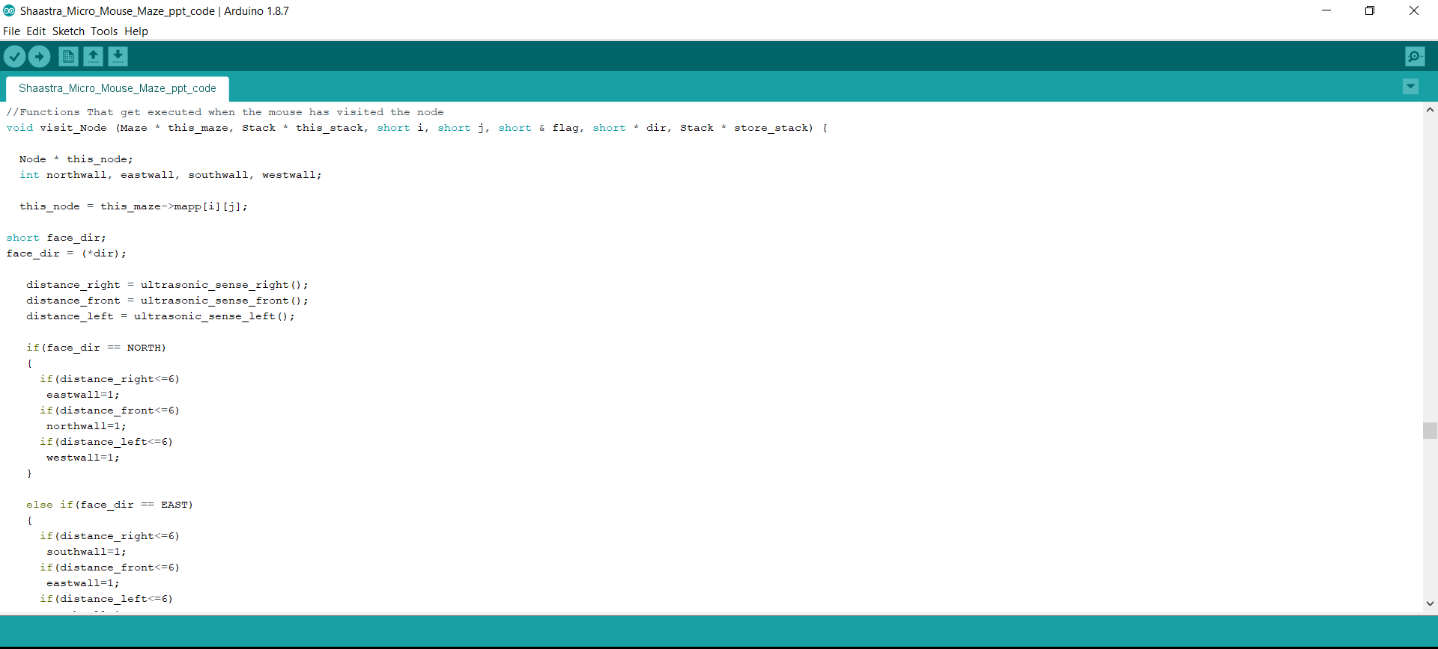

Slide 37
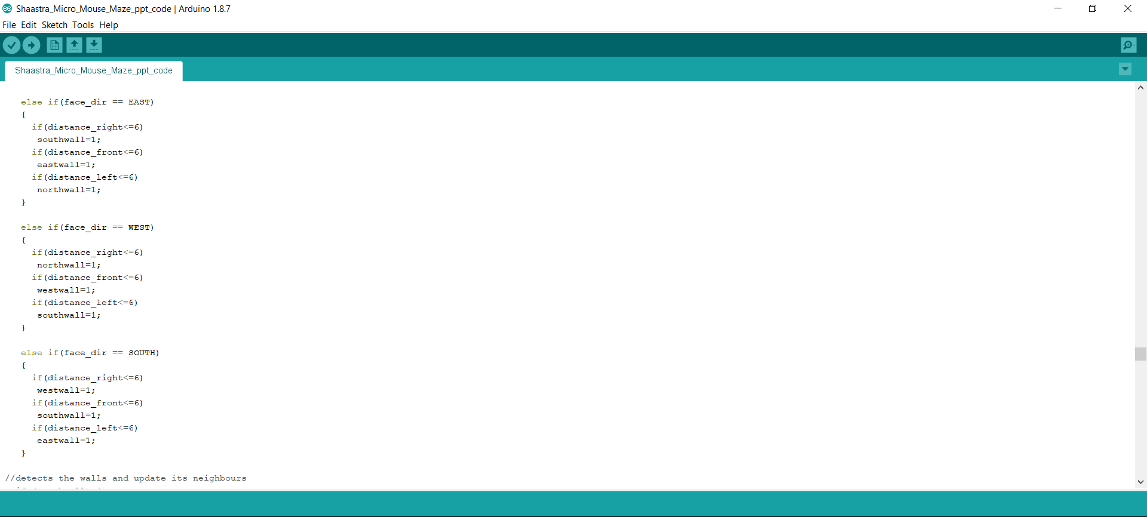

Slide 38
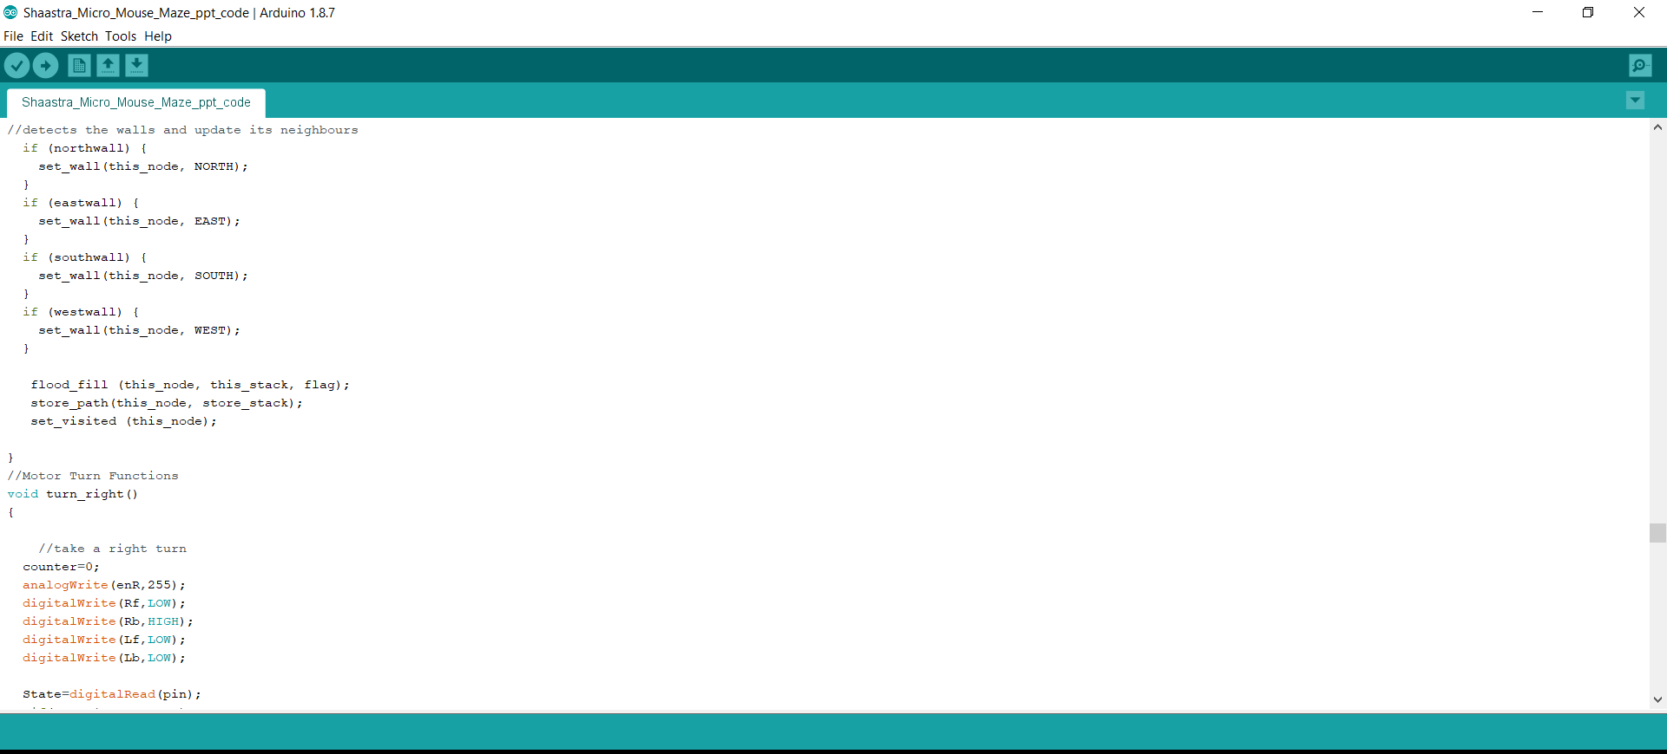

Slide 39
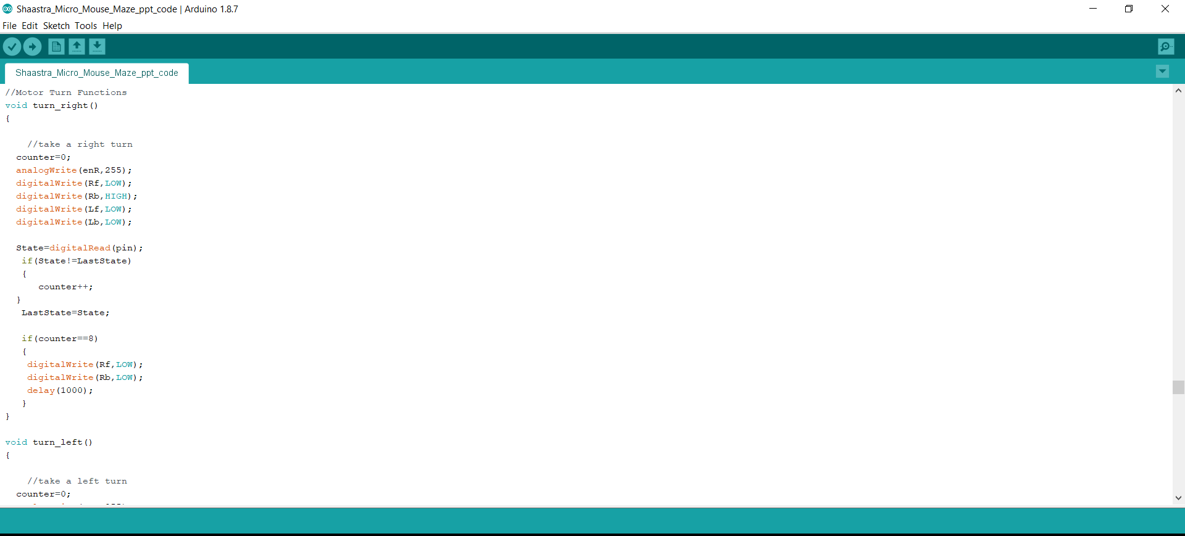

Slide 40
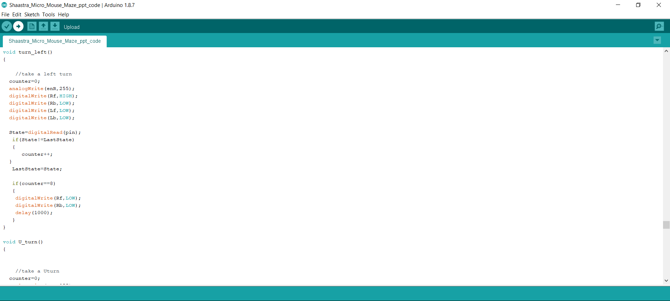

Slide 41


Slide 42


Slide 43


Slide 44


Slide 45


Slide 46


Slide 47


Slide 48


Slide 49
MICRO-MOUSE MAZE SOLVER ROBOT
Opto-coupler Encoder
Arduino UNO
Ultrasonic Sensor
Micro-Mouse Maze Solver Robot
Motor Driver

Slide 50
Thank You
Team Name: HORIZON
SHAASTRA 2019-IIT MADRAS

